Slide 1
Global Challenge Programme
Decolonising and the NHS Keele university, 9th October 2024
Dr Annabel Sowemimo
Annabel.sowemimo@kcl.ac.uk
Community Sexual & Reproductive Health Consultant
Phd Candidate King’s College London

Slide 2
Dr Annabel Sowemimo
Author of Divided: Racism, Medicine and Decolonising Healthcare
Community Sexual & Reproductive Health Consultant in the NHS
Founder of Reproductive Justice Initiative Charity (formerly Decolonising Contraception)
Phd Candidate at KCL, Harold Moody Scholar
Freelance writer

Slide 3
Objectives
Introduce key discussions within race and health
Introduce how race science was established and how racial health inequalities persist
How decolonising can be used to dismantle racist epistemologies
Understanding racial categorisation within medical research and how it exerts meaning
Understand how racial capitalism links National Health Service (NHS)
Discuss methods to overcoming racial disparities in health care

Slide 4
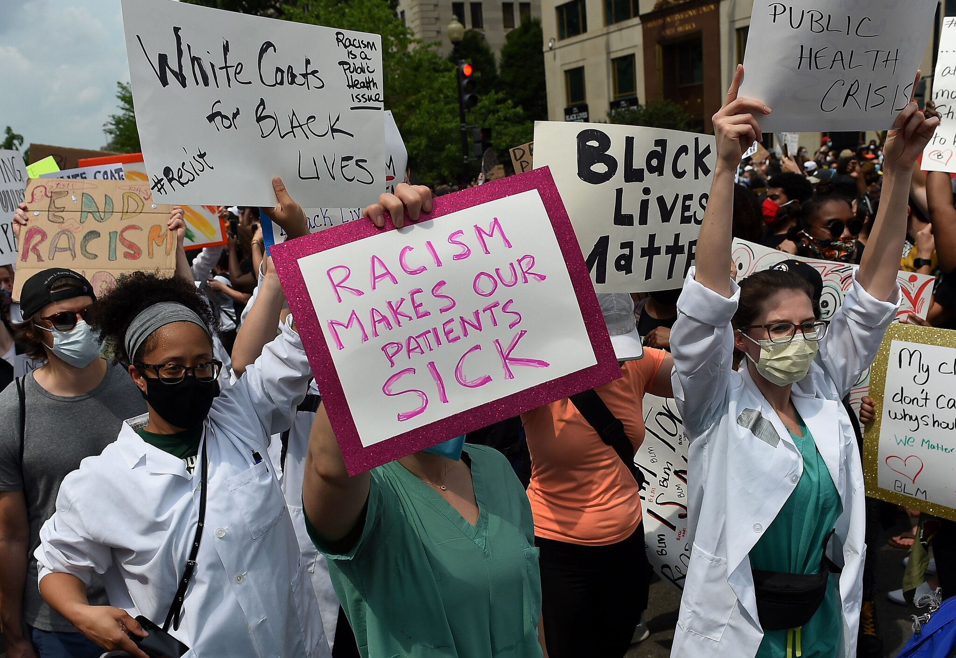

Slide 5
“Decolonising the curriculum’ has been the keynote theme at a many seminars, conferences, and workshops both within individual disciplines and across them. At times, references to ‘decolonising’ seems so capacious as to stand in for any form of critical engagement with race and representation, or indeed, the mildest of curricular reforms.”
- Professor Priyamvada Gopal (2021) On Decolonisation and the University

Slide 6
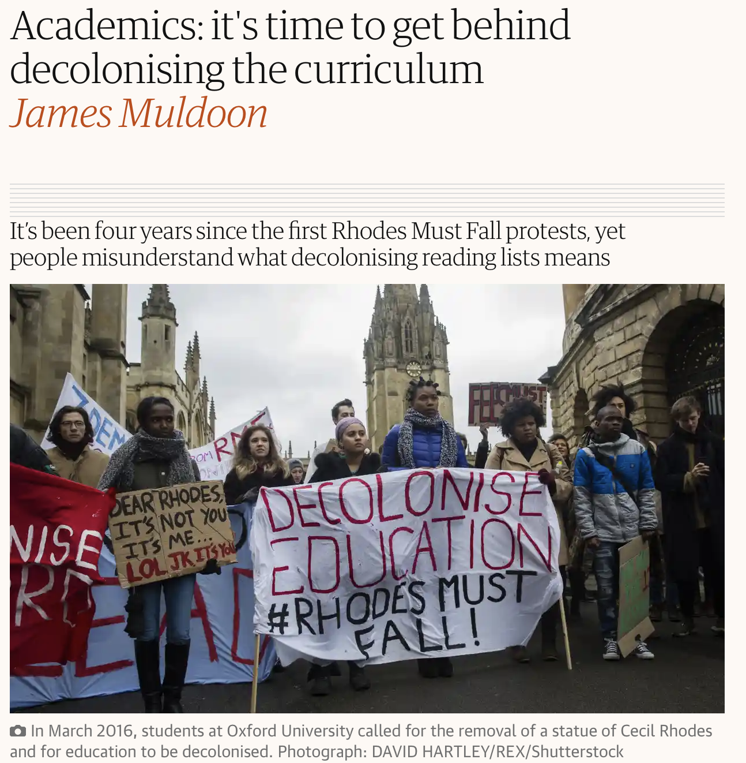
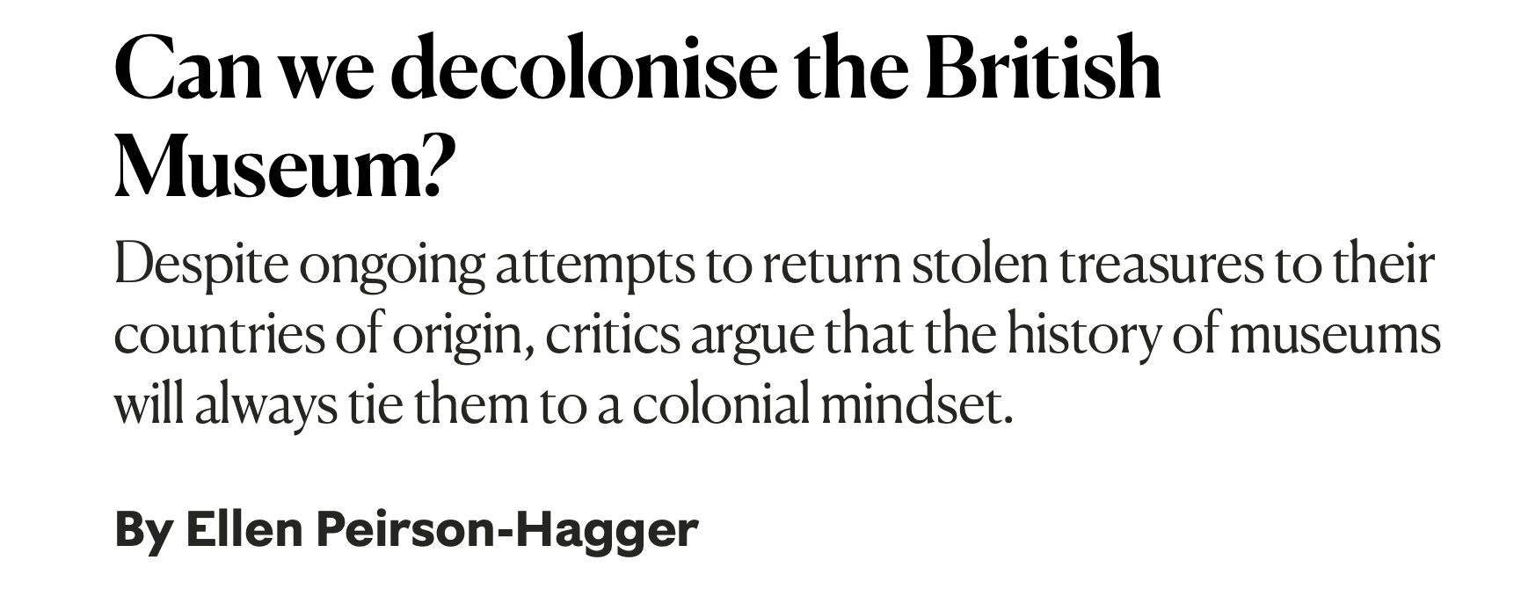
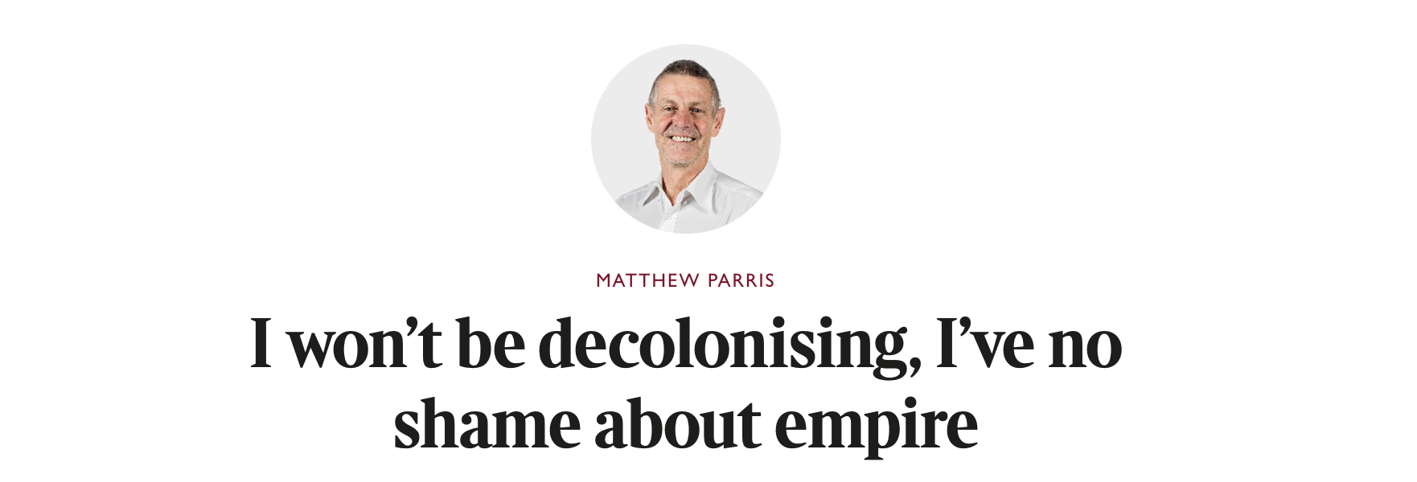

Slide 7
“Such perspective does not mean a rejection or negation of Western thought; in fact, Western thought is part of the pluriversal. Western thought and Western civilization are in most/all of us, but this does not mean a blind acceptance, nor does it mean a surrendering to North Atlantic fictions.” - Mignolo, Walter D and Walsh, Catherine E. On Decoloniality

Slide 8
Decolonising and Our Institutions

Slide 9
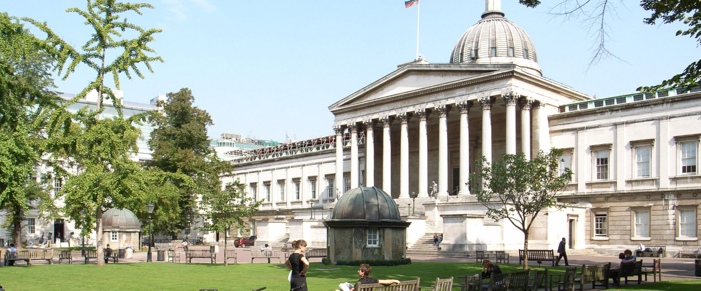
University College London
Founded in 1826 as a secular institution
Became home to Galton’s Laboratory that gave way to the Eugenics movement in 1904
In 2018, it emerged that it had hosted a Eugenics conference and an investigation was launched

Slide 10
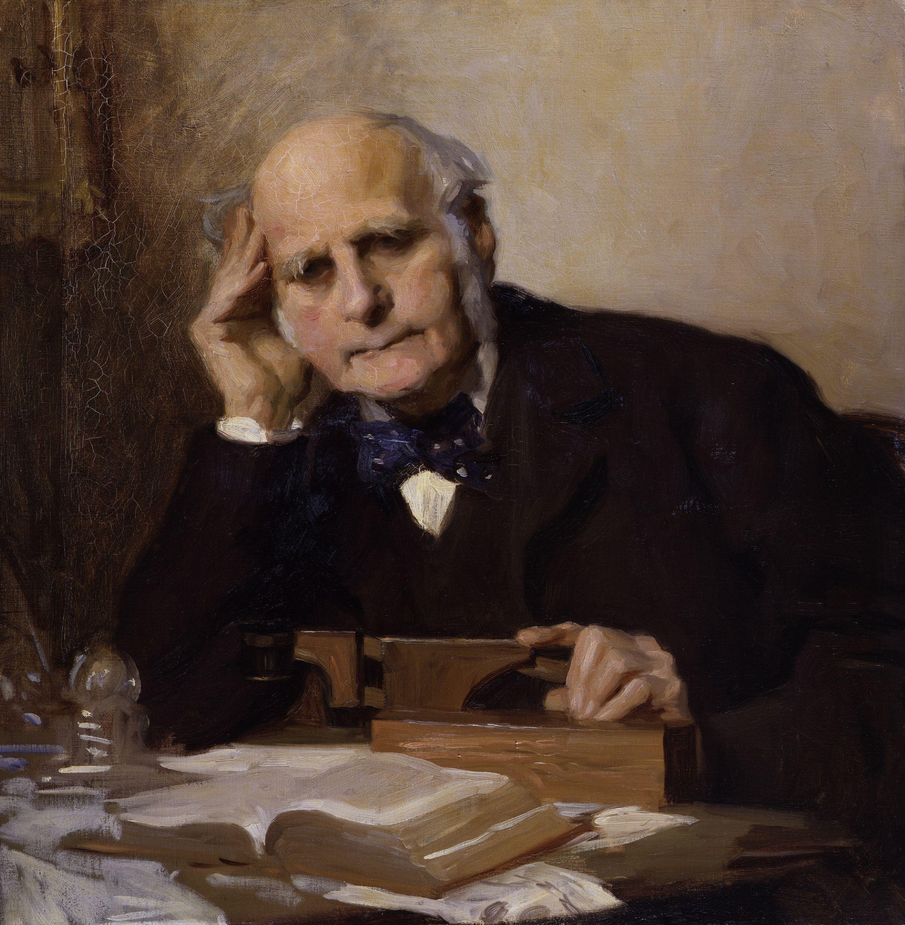
The rise of Eugenics
A Victorian “polymath” best known as the creator of Eugenics, formally named in 1883
Cousin of Charles Darwin and greatly inspired by what became Darwin’s theory of natural selection
His progeny Karl Pearson would become the first Professor of Eugenics & help spread it across the globe
Sir Francis Galton
(1822 - 1917)

Slide 11
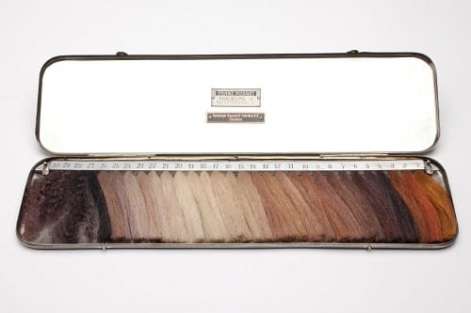
Dr. Eugen Fischer’s Haarfarbentafel, or hair colour scale

Slide 12
Decolonising and Our Science

Slide 13
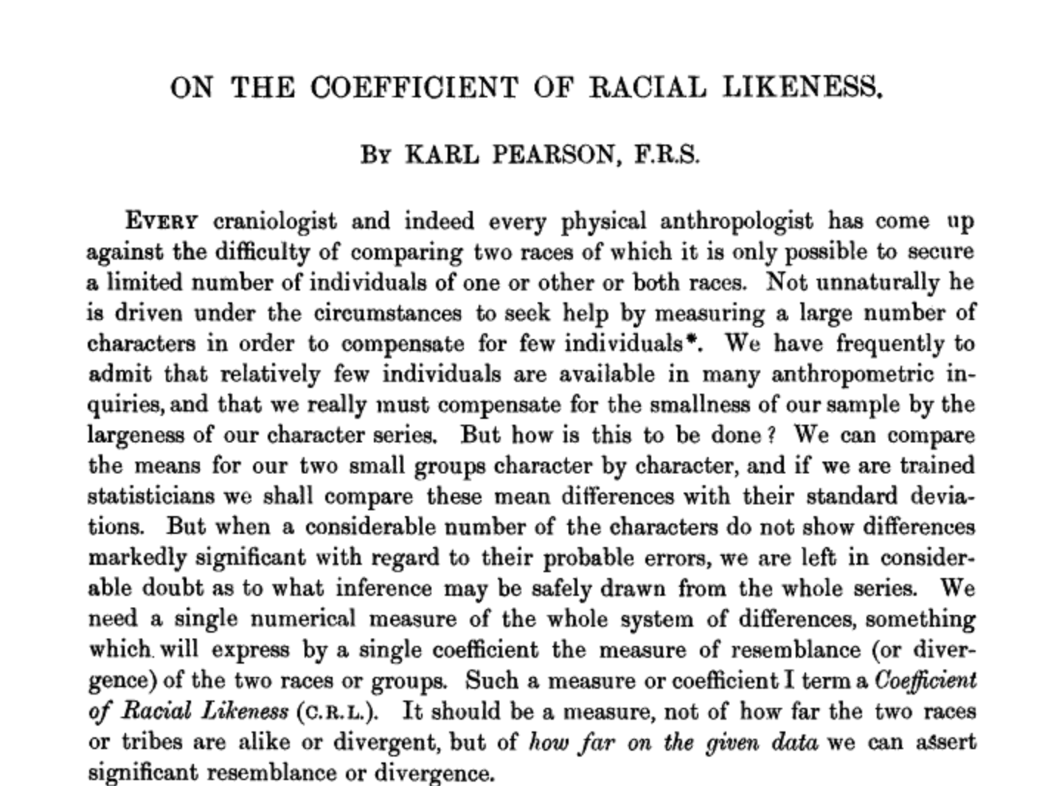
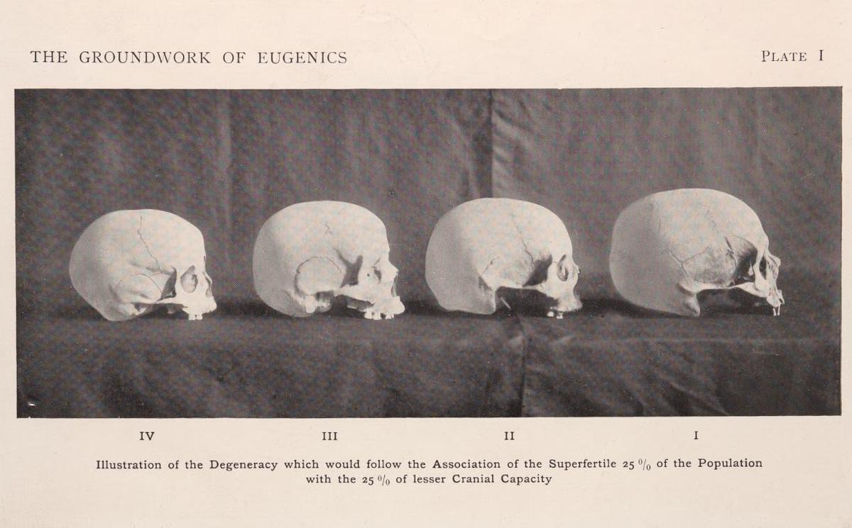
The Groundwork of Eugenics by K.Pearson in July 1926
Academic Paper in Biometrika published by K.Pearson in July 1926
Notes:
Colour Plate : Plate I: Illustration of the Degeneracy which would follow the Association of the Superfertile 25% of the Population with the 25% of lesser Cranial Capacity.

Slide 14
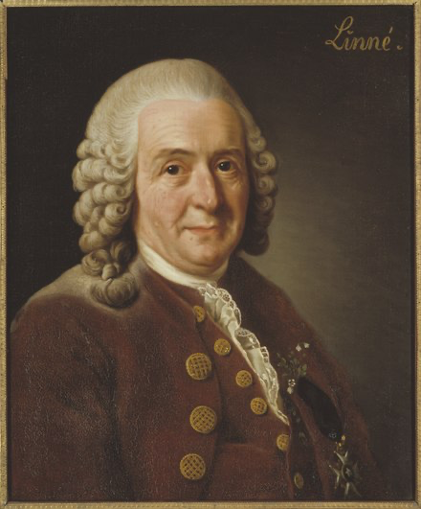
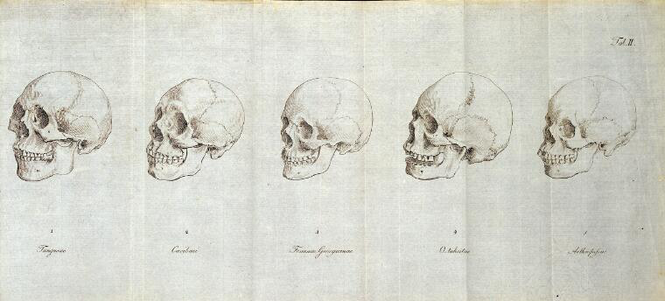
Colonialism & the Establishment of Race Science
Carl Linneaus (1707-1738), Swedish botanist and scientist, credited with some of the earliest racial categorisation
Johann Friedrich Blumenbach (1752 -1840) German physician, physiologist credited with some of the earliest racial categorisation – Caucasian, Mongolian, Malayan, Ethiopian, American
Notes:
Brief overview of how colonisation and science have worked together to create system of racial categorisation

Slide 15
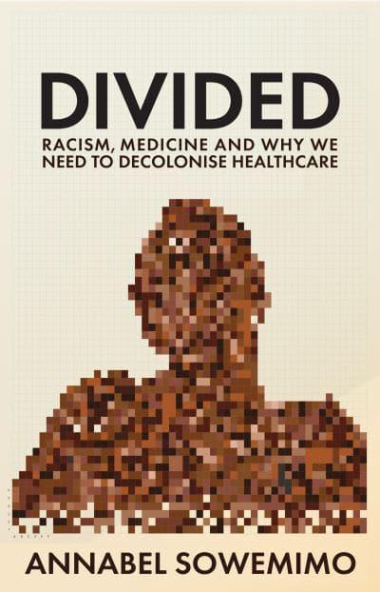
The plantation and scientific racism
Plantation owners, early European explorers perpetuated myths
Edward Long, wrote the History of Jamaica widely read
Suggested that Africans had ferocious sexual appetite
That Africans could mate with Orangutans
Black African women as menstruating early, feeling less pain in childbirth
These myths were built upon and disseminated; to reinforce the idea that slavery was acceptable

Slide 16
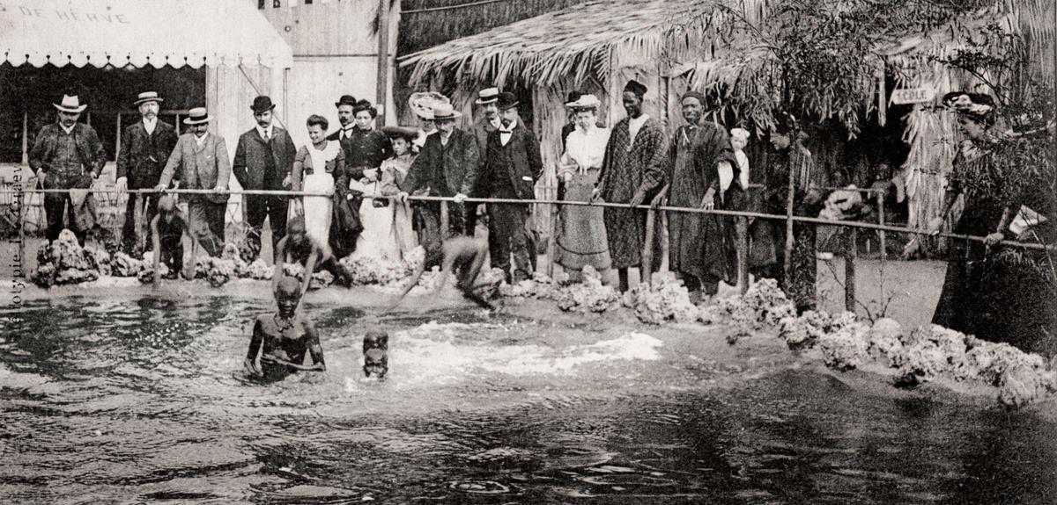
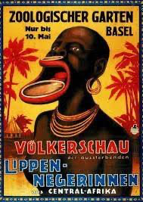
The Human Zoo - As Propaganda
Notes:
19th- and 20th-century public exhibitions of humans, usually in an erroneously labeled "natural" or "primitive" state. One-man human zoos also existed as early as the 17th century in Europe.^{[1]} The displays often emphasised the cultural differences between Europeans of Western civilization and non-European peoples or with other Europeans who practiced a lifestyle deemed more primitive.^{[2]} Some of them placed indigenous populations in a continuum somewhere between the great apes and Europeans.^{[3]} Ethnological expositions are now seen as highly degrading and racist, depending on the show and individuals involved.

Slide 17
Delta of Venus: Saartjie Baartman
Part of the Khoi Tribe
Considered the missing ethnic link between human and the ape species
She was taken across Europe to exhibited
Suffered rape and regular intimate physical examinations
On her death in 1817 she was dissected by George Cuvier, a French zoologist – her brain, genitals were placed in glass jars stored in parisian museum until 1976
Notes:
Meaning ‘little Sara’ in Afrikaans.
Born in 1789, the year of the French Revolution
Lasting repercussions on how Black women are perceived in society and therefore medicine

Slide 18
How has colonial race science shaped our ideas of race and health today…

Slide 19
White Supremacy is central to our current scientific model
White supremacy - ‘the belief that the white race is inherently superior to other races and that white people should have control over people of other races’ and as ‘the social, economic, and political systems that collectively enable white people to maintain power over people of other races.’
Merriam Webster dictionary definition

Slide 21
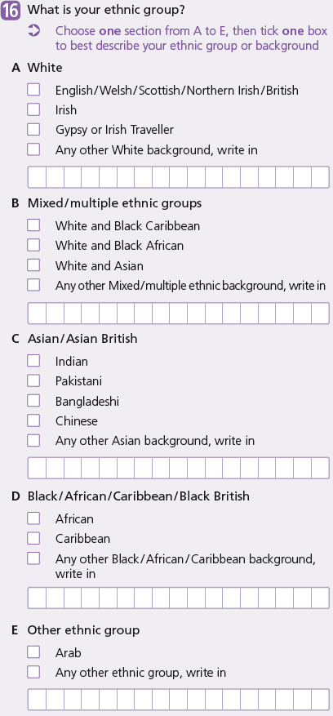
Just tick a box?
Notes:
Before I start - Please look at this census image and have a think of why

Slide 22
Race as modifiable
“Moving forward requires rejecting the scientific fallacy that race and ethnicity are static, non ­modifiable risk factors…”
- Selvarajah, Sujitha et al., (2022). Racism, xenophobia, and discrimination mapping pathways to health outcomes. The Lancet vol 400 issue 10368 p2109-2124 https://doi.org/10.1016/S0140-6736(22)02484-9

Slide 23
Racialised Management

Slide 24
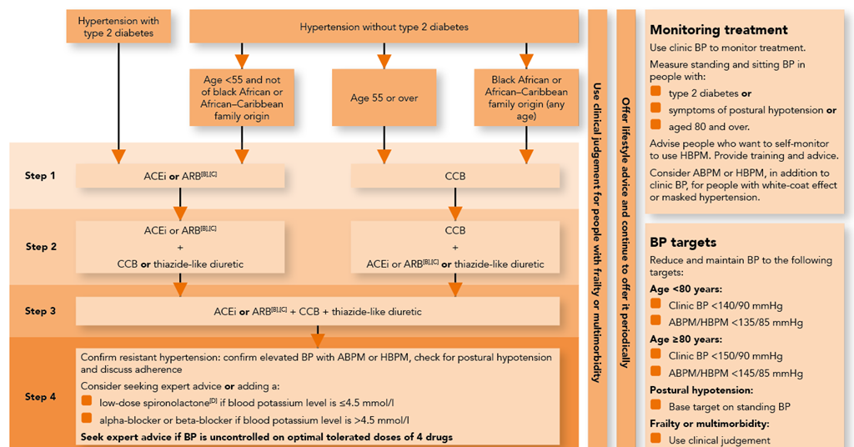

Slide 25
Bidil - The first “Black” specific medication

Slide 26
And yet…
Skin tone is ignored in more crucial areas…

Slide 27
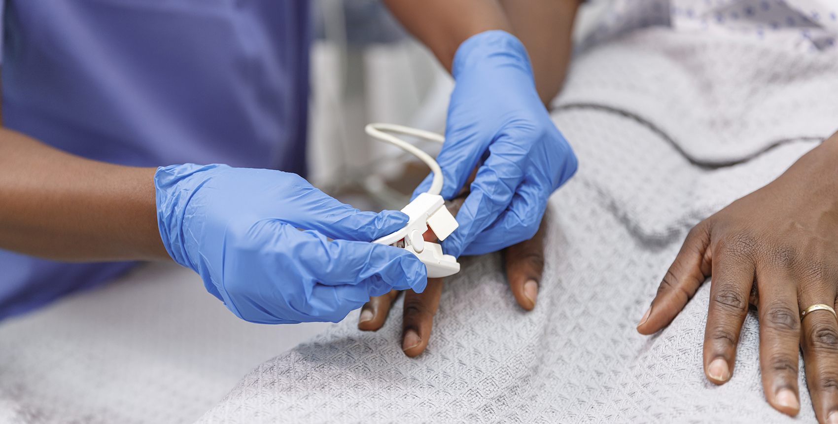
The Problem with Pulse Oximetry
Pulse oximeters measuring oxygenation levels, a crucial tool during height of COVID-19 pandemic
First studies suggesting greater accuracy in darker skin in 2007
During pandemic public encouraged to buy pulse oximeters
Announced in 2021, government to investigate inaccuracy in pulse oximetry in those with darker skin
2023 NHS Race and Health Observatory Report released

Slide 28
Decolonising Our Health System

Slide 29
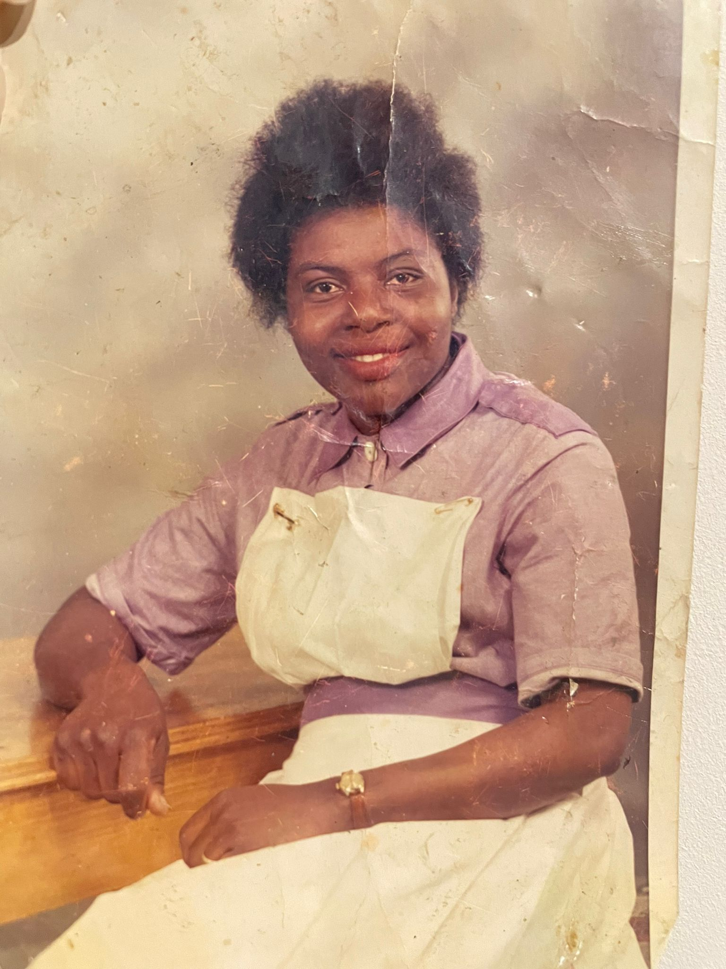
My Nana in her nursing auxiliary uniform in the 1950s, Royal Free

Slide 30
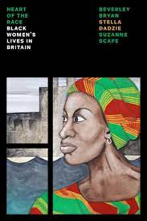
“Black women have for years tolerated the lowest-paid jobs and the least satisfactory working conditions. Profits have always come before the health of employees, but there is no denying that we Black women have to deal with a disportionately high share of health hazards at work. Even within the health industry, we face short-term risks and long-term dangers to our physical and mental well-being as a direct consequence of the work we do.”
- Bryan et al. (1985) Heart of the Race: Black women’s lives in Britain (1985) p91

Slide 31
Nana Talking on about the idea of the “motherland”

Slide 32
“So you have to take that into account when looking at what happens to us here in Britain. You only have to talk to Black women – the number of us who suffer consequences of bad birth techniques, for example, where the afterbirth is left in and becomes infected; or the number of us who get sterilised against our wishes, because some doctor persuades us to have it done when we go to hospital for something completely different.” Account from a Black women in Heart of the Race: Black women’s lives in Britain p104

Slide 33
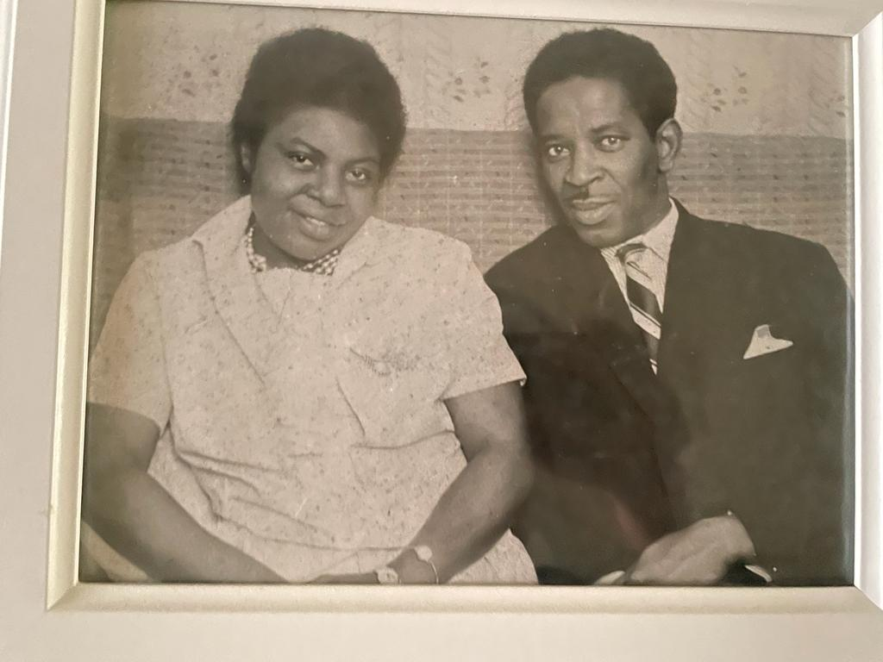
“Farming” Amongst Black West African Families

Slide 34
“Farming” Amongst Black West African Families
Between 1950s – 1970s West African families ‘farmed’ children to white families
Estimated by 1986 5000 West African children unofficially fostered in Britain – perfectly legal practice
Often ‘fostered’ to allow them to work or study
Whilst many positive experiences , many negative experiences
At least 18 cases of African children dying in private foster homes between 1961 - 1964

Slide 35
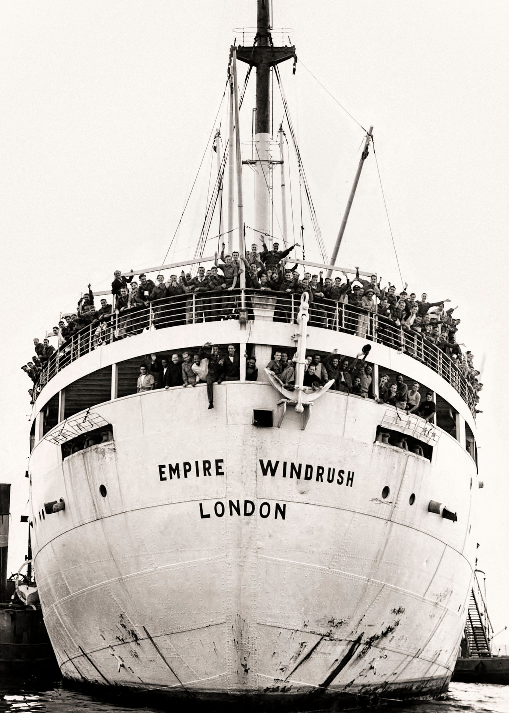
The National Health Service (NHS) was established in 1948, the same year of the arrival of Empire Windrush.

Slide 36
“The UK government is slashing our aid budgets that support weaker health systems, and at the same time it continues to extract cheaper healthcare professionals from some of the poorest parts of the world. The next time you are treated by an overseas healthcare worker in the UK, US or another wealthier country, you might want to thank them. Someone else’s health is suffering so that yours will not.”

Slide 37
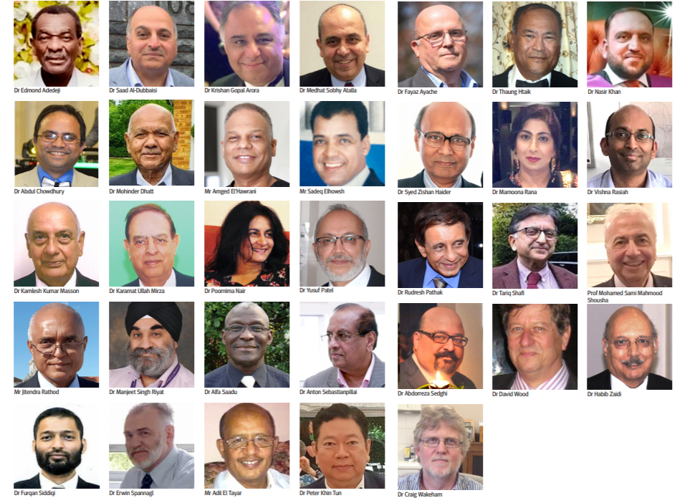
Healthcare workers dying of COVID-19
1.2 million staff employed by NHS, 20.7% belong to Black, Asian and minority ethnic (BAME) background.
analysis of deaths of NHS Staff during the pandemic showed that 64% of those who died belonged to BAME background
How did this happen? .

Slide 38
“The lack of diversity at the most senior levels of healthcare both within the UK and globally further reinforces the idea that medical institutions are still not treating everyone’s health equally. The NHS is often commended as being one of the most diverse workforces in the world, with up to 41 per cent of staff in some regions being from racially minoritised backgrounds. However, most of them occupy the lowest paid positions, with less than 8 per cent occupying senior positions.”

Slide 39
So where do we go from here….

Slide 40
Decolonising Frameworks
‘To decolonise is to acknowledge the often, harmful role that colonisation has played in distorting knowledge and restructuring our society; it asks how we may dismantle epistemologies derived through colonialism and instead centre the experiences of indigenous populations’
adapted from Decolonizing Methodologies, T.Smith

Slide 41
Decolonising Healthcare
Contextualising our current system of healthcare
Making our systems more inclusive and equitable
Dismantling & questioning practices that reinforce harmful systems
Devising new systems that do not replicate the old ones

Slide 42
Changing how we think about Race
“It is important to distinguish ancestry from a taxonomic notion such as race. Ancestry is a process-based concept, a statement about an individual's relationship to other individuals in their genealogical history; thus, it is a very personal understanding of one's genomic heritage. Race, on the other hand, is a pattern-based concept that has led scientists and laypersons alike to draw conclusions about hierarchical organization of humans, which connect an individual to a larger pre-conceived geographically circumscribed or socially constructed group …”
- Yudell, Michael, et al. “Taking Race out of Human Genetics.” Science, vol. 351, no. 6273, 2016, pp. 564–65. JSTOR

Slide 43
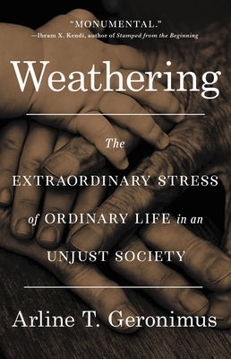
Weathering
Coined by by Dr. Arline Geronimus, now a Professor in Health and Behavior at the University of Michigan in Ann Arbor.
“that the health of African American women may begin to deteriorate in early adulthood as a physical consequence of cumulative socioeconomic disadvantage.”
Uses the concept of allostatic load by Dr. Bruce McEwen and Dr. Eliot Stellar the physiological “cost” of chronic, or repeated, exposure to stress which causes deterioration over time

Slide 44
Get in Contact

Slide 45
References
Selvarajah, Sujitha et al., (2022). Racism, xenophobia, and discrimination mapping pathways to health outcomes. The Lancet vol 400 issue 10368 p2109-2124 https://doi.org/10.1016/S0140-6736(22)02484-9
Sowemimo, Annabel (2023) Divided: Racism, Medicine and Decolonising Healthcare. Profile Books/Wellcome Collection
Yudell, Michael, et al. “Taking Race out of Human Genetics.” Science, vol. 351, no. 6273, 2016, pp. 564–65. JSTOR http://www.jstor.org/stable/24741617.
Heart of the Race: Black Women’s Lives in Britain The Uncaring Arm of the State: Black Women, Health and the Welfare Services. Chapter 3
MBRACE REPORT 2018 https://www.npeu.ox.ac.uk/mbrrace-uk/reports

